Slide 1



Hasmukh Goswami College Of Engineering
Information Technology Engineering
Subject : Internship/Project (3181601)
Semester : 8
Role : Intern
Internal Guide : Prof. Vaidehi Shah

Slide 2

About Company
Projects Completed
800
Projects
Hornbook is a well-established IT company in Ahmedabad. Having initiated operations in 2010, today, Hornbook has emerged as one of the leading Web development and web design company in Ahmedabad. We craft beautiful, engaging websites and deliver successful SEO campaigns. We have the right expertise and attitude to understand the needs, complexities and nuances of your business processes and priorities. Our team of young and energetic professionals has a flare for serving cross section of clients.
Happy Clients
50
Clients
Countries We Serve
8+
Countries
Team Members
25
Members

Slide 3
Working Technologies
Front-end :Angular |React |Vue Js |Html CSS
Back-end :.NET |Java |Node Js |PHP |Python
Database :SQL Server |MySQL |ORACLE |MongoDB |Dynamo Technology

Slide 4
Project : सFAR
सFAR is a tour booking Web-Application which consists of various packages. Moreover, there is a gallery which has pleather images of the beauty of India. User can login and find their tours. User can book their tour packages by filling form.
Customers:-
Customers can book tour packages by the filling form.
Service Providers:-
These are the main users of the portal. सFAR would get the business if the good number of quality service providers available to serve the customer’s booking.
Admin:-
Admin or Backoffice users would be helping customers or service providers through the admin interface. And handling the booking data.

Slide 5
Project : सFAR
Admin should be able to see all the registered users and should be able to approve first time registered users.
Admin should be able to see all the service requests and they should have ability to reschedule or cancel any service request.

Slide 6
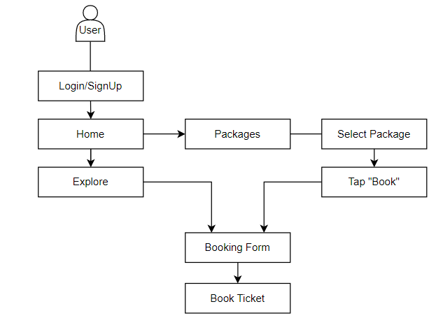
Workflow
How To Book Package

Slide 7
Tools & Technologies Used In Project
Front end : HTML | CSS | Bootstrap | ReacJs
Back end : ReactJs | JavaScript
Database : JSON File
Tools/IDE : Visual Studio Code

Slide 8
Front-End
Front-End
Home Screen & Public Pages
Home Screen
Packages
Gallery
Contact Us
About Us
Signup/Login
Login
Sign up
Service Provider Sign up
Forgot password
Book Package
Go to Explore
Schedule & Plan
Your Details
Make Payment
Customer’s pages
Dashboard
Booking History
Profile

Slide 9
Front-End
Admin Page
Booking Data
Edit/Delete
Manage Users
Good to Have Features
Wonderful Packages
Tour Schedule

Slide 10
Database
There is only a “JSON” file as database in our project.
Link :
https://api.jsonbin.io/v3/b/6453572e9d312622a357270c

Slide 11
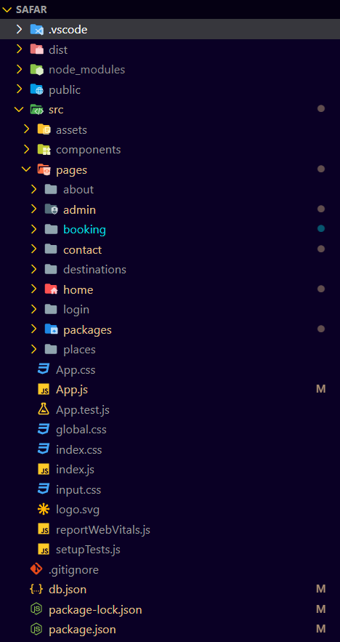
Folder Structure

Slide 12
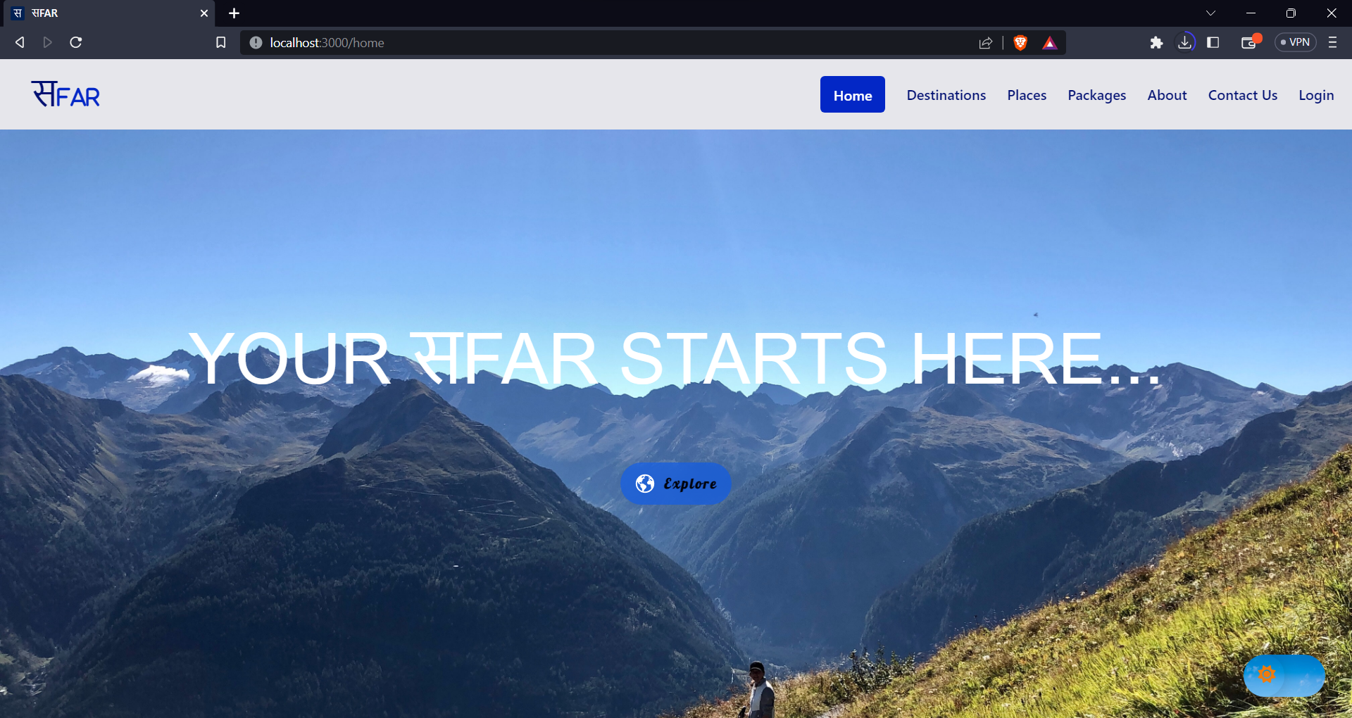
Home Page

Slide 13
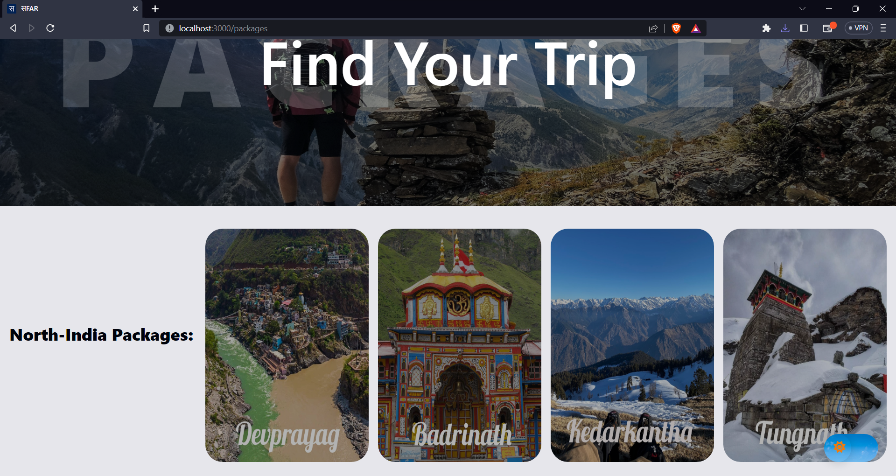
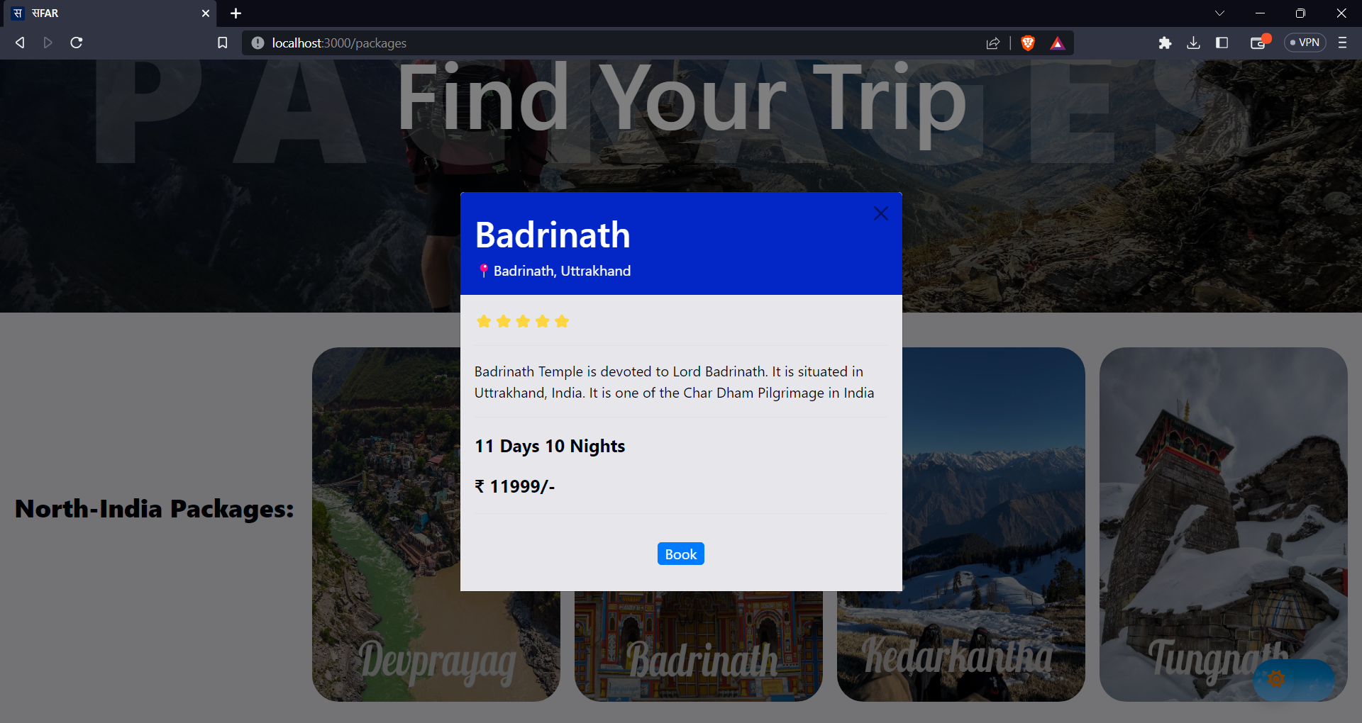
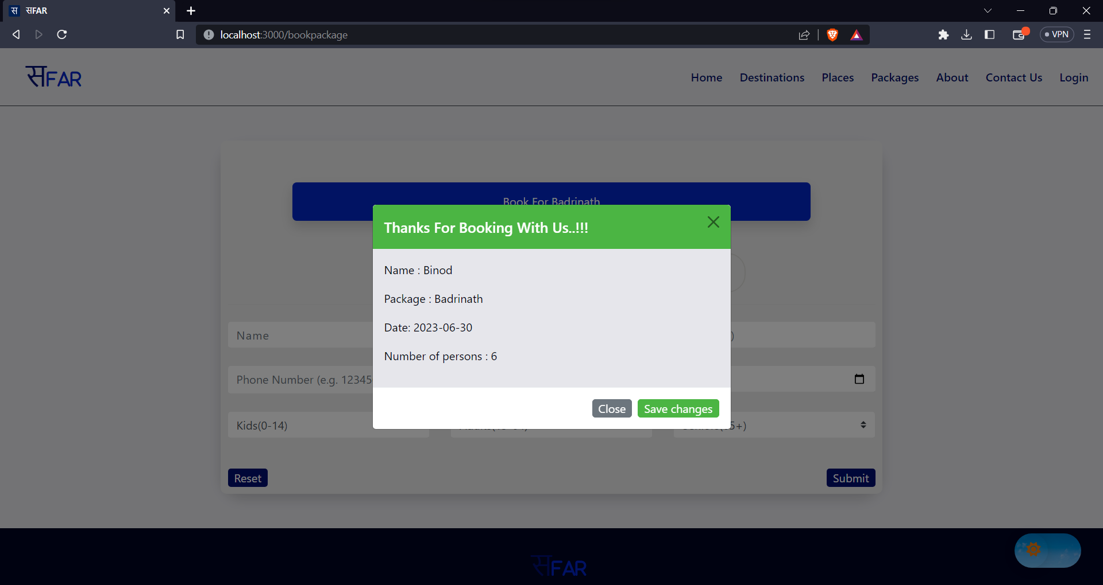
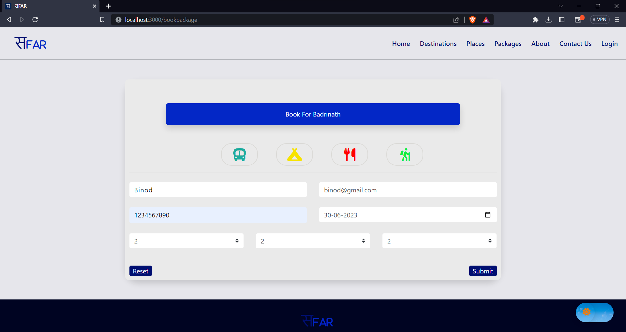
Booking A Package
Click “Book”
Choose Package
Done
Fill Details

Slide 14
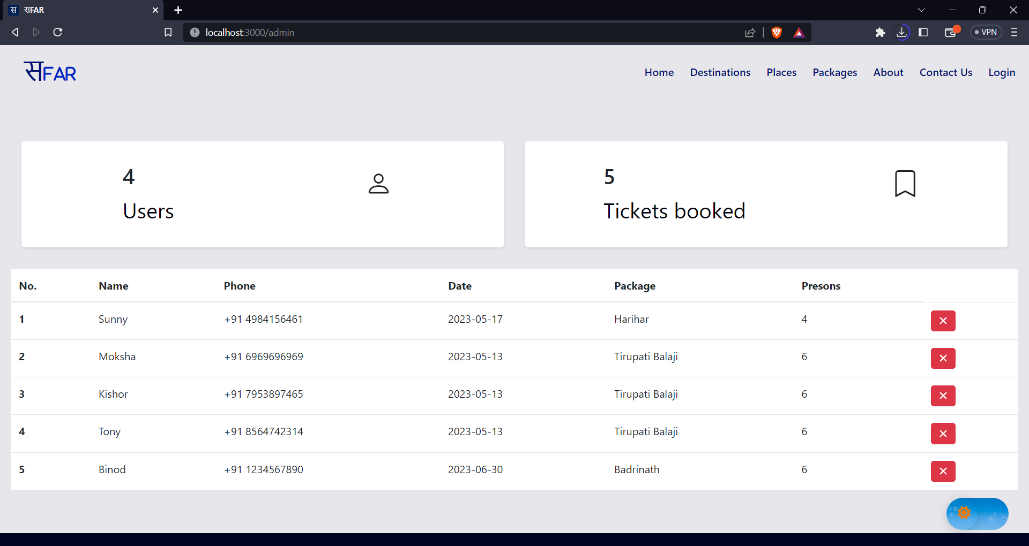
Admin Page

Slide 15
Thank You

